Slide 1
Hurricane Harvey and the New Urban Economics of Climate Change Adaptation
Matthew E. Kahn
@mattkahn1966
kahnme@usc.edu
University of Southern California

Slide 2
Introduction
Urban resilience as an attribute of urban quality of life,
my 2010 Climatopolis book
My 2015 paper “Cities and the Environment” (joint with Walsh)
When 11 trillion gallons of water land in a small geographic space, implications for
Fatality risk
Damage to the capital stock
Damage to local productivity

Slide 3
Adapting to Fat Tail Risk
Hurricane Harvey is a leading example of a shocking event
11 trillion gallons of water falling in less than 1 week
Weitzman’s work on fat tail events features no spatial adjustment margins, assumes away a huge # of adaptation margins
Shocks occur to places
General equilibrium effects
Shocks are partially anticipated
We are risk averse
Many of us know that we don’t know what Mother Nature will throw at us

Slide 4
Harvey’s Low Death Rate
10 million people in the affected area and 80 deaths
My 2005 RESTAT paper the Death Toll from Natural Disasters
Why were there so few fatalities?
The role of self protection such as evacuation
The role of cell phones and directed search by first responders

Slide 5
Adapting to Terrorism vs. Natural Disasters (Kahn 2015)
Geographic Persistence to natural disaster shocks
Rational terrorist is more strategic and chooses targets at random so that we cannot prepare
Spatial predictability of Mother Nature leads to capitalization of risk into real estate prices (implications for the poor!)
Spatial predictability --- implications for insurance risk pricing and encouraging self protection
Implications for infrastructure and zoning codes and density zoning

Slide 6
Cities as Bundles of Attributes
If you met a space alien, how would you describe “Houston”?
Employment base, climate, home prices, culture, humidity, history, food
Houston is known for energy, Republicans, cheap housing, humidity, and flooding.
Houston = the “American Dream”? For some “yes”, for others “no”
We are diverse and we vote with our feet
Houston attracts people who want cheap large homes.
Millions have chosen to live there rather than San Francisco.
Does Harvey “change things”?

Slide 7
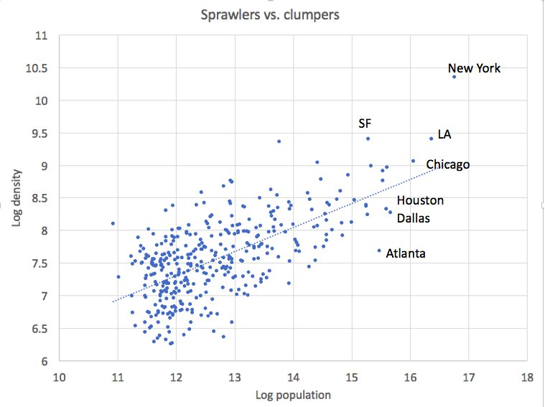
Paul Krugman on 9/3/2017, Houston= Sprawl

Slide 8
Sprawl = Private Benefits but Social Costs
Houston has chosen to sprawl and to have more single family homes than San Francisco
Paul Krugman → This has had the unintended consequence of raising flooding risk
By how much?
Household Willingness to pay for Single family homes vs. an apartment in multi-family housing

Slide 9
But We Keep Rebuilding
Do we learn from our mistakes? (behavioral economics and adaptation)
Benefits of rebuilding, middle class housing that is cheap
No free lunch
Externality imposed on others; wetlands converted into concrete imposes flood risk on all, how big is this externality?
private land trusts could purchase flood plain land and set it aside as wetland parks, reduce flood risk by x%.

Slide 10
Politics and Adaptation
Place based congressmen seek infrastructure (ex-ante $) and rebuilding $ (ex-post) for their areas
Two Deadweight losses induced by this activity
Distortion in the location decision of people
Standard DWL for paying or this expenditure

Slide 11
My New Work
Kerry Smith and I are working on this issue
A benevolent planner would upzone on “higher ground” and move urban activity to this area
Taxpayer revolt against subsidizing risky living?
Economic incidence of these implicit subsidies; home owners (not renters) in these areas
Explicit discussion of property rights in a changing world (climate change shifts the bundled attributes of a given parcel of land)
Are incumbent property owners residual claimants on “bad news”?

Slide 12
Urban Productivity and Climate Change
Endogenous adoption of air conditioning (Graff-Zivin and Kahn 2016), the most productive firms adopt air conditioning and hence aggregate industrial output is insulated.
Short run shocks such as oil refining post Harvey --- If disruptions occur, capital will start to move to “higher ground”. General equilibrium price effects and spread out diversified production shield the macro-economy.

Slide 13
Rising Income Inequality in Houston?
Boustan et. al. (2017) , 90 years of natural disasters
When major disasters occur, population shrinks and poverty rate for a county increases.
Poor owners will bear the greatest incidence of the shock.
Poor people live in the highest risk areas and have the fewest adaptation strategies. The call for universal pre-K and a basic income level (Milton Friedman) become even more important in a world featuring rising climate change risk.

Slide 14
Urban Competition
Those areas that attract and retain the skilled grow.
Which geographic areas wins and loses if the Houston region doesn’t compete well?
Durable capital and Glaeser and Gyourko’s 2005 JPE paper
Bunten and Kahn (2016) and the economics of Lego, decouple capital from land or have a less durable capital stock.
Even climate deniers will notice if their area suffers a “brain drain”

Slide 15
Tiebout Meets Harvey
Open system of cities and system of neighborhoods within cities
Local homeowners pay for their own defense.
Use property taxes to buy property set it aside as wetland to reduce flooding
What happens to those who can’t easily move? (cheaper rents)

Slide 16
Conclusion
We hold “Undiversified portfolios”
Why?
We have a job in a specific place and own a home and have our friendship networks and past there.
Consider adaptation for an Asst. Prof who rents, she does not bear the incidence of place based shocks.
Uncouple shocks to place and urbanites ➔ adapt more easily

Slide 17
The “New Economy” and Adaptation
“Uber Disaster”; peer to peer sharing of canoes and other rescue devices
“surge pricing”? (Titmus vs. Hayek)
AirbNb and housing those who have been dislocated
If the poor cannot afford this, crowdsourcing rescues and financing them.
Forget “egames”, now the unaffected areas can actively help as a crisis ensues.
The allocation of scarce resources to save lives during an increasingly risk time.
Catastrophe bonds and risk rated insurance by land parcel
Kahn, Jones and Nolan (2017 Harvard Business Review)

