Slide 1
Some Thoughts on an Energy Policy for a Sustainable Future
Gilbert E. Metcalf
Tufts University and NBER
iSEE Congress 2016
Energy 2030: Paths to a Sustainable Future
September 14, 2016

Slide 2
Topics
Thoughts on a carbon tax
Tax preferences for oil & gas production
R&D

Slide 3
Carbon Tax:
Setting the Tax Rate
Pigouvian pricing
Emission reduction targets
Revenue targets
Political targets

Slide 4
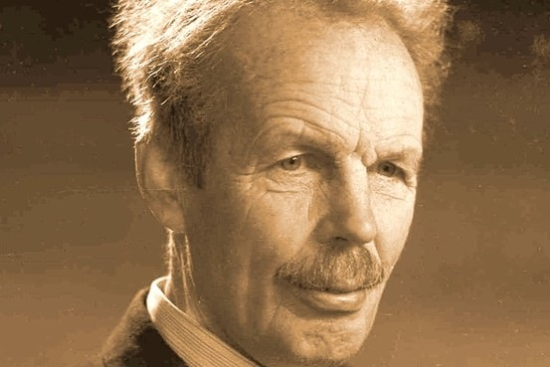
1. Pigouvian Pricing
Cap and Trade or Carbon Fee? Both are examples of Pigouvian pricing!
Arthur pigou, 1877 - 1959

Slide 5
SCC and the Tax Rate
Social cost of carbon is a dollar measure of the damages from one more ton of CO₂ emissions in any given year
SCC is a measure of marginal damages from pollution
Pigou’s prescription: set tax equal to SCC
A classic prescription to deal with pollution
What is the social cost of carbon?

Slide 6
Social Cost of Carbon
$71
$32
U.S. Interagency Working Group (2015)

Slide 7
2. Emission Reduction Target
Paris INDC
“…the United States intends to achieve an economy-wide target of reducing its greenhouse gas emissions by 26-28 per cent below its 2005 level in 2025 and to make best efforts to reduce its emissions by 28%.”
Aspirational Target
“This target is consistent with a straight line emission reduction pathway from 2020 to deep, economy-wide emission reductions of 80% or more by 2050.”

Slide 8
Emission Scenarios
-19%
-28%
Rausch and Reilly (2015)

Slide 9
3. Revenue Target
10 year revenue shortfall for a “realistic” corporate income tax reform could be offset by a carbon tax of $20 per ton growing at 3 to 5 percent per year.
  20 percent top corporate income tax rate
  Preserve MACRS, interest deductibility, and R&D tax credits/expensing

Slide 10
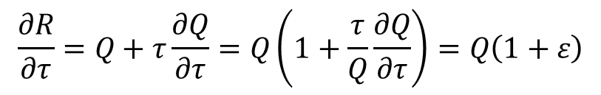
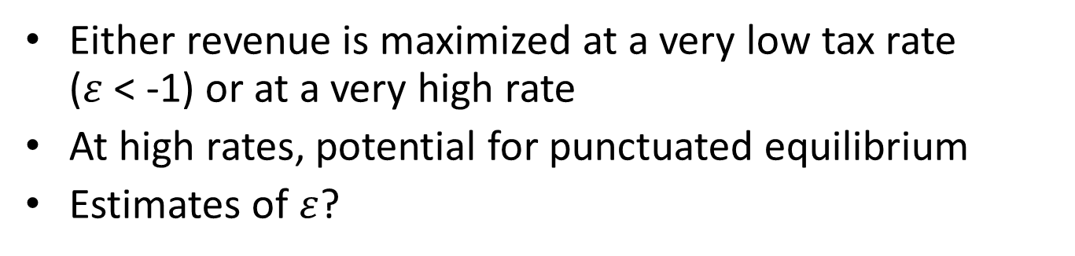

Setting the Rate with a Revenue Target
Approach 1: “I need $100 billion…”
Approach 2: “How much can we raise?”
$$R=τQ$$
$$\frac{∂R}{∂τ}=Q+τ\frac{∂Q}{∂τ}=Q\left(1+\frac{τ}{Q}\frac{∂Q}{∂τ}\right)=Q\left(1+ε\right)$$
Either revenue is maximized at a very low tax rate ($ε$ < -1) or at a very high rate
At high rates, potential for punctuated equilibrium
Estimates of $ε$?

Slide 11
4. Political Target
Set rates to get a tax through Congress
How do we ensure sufficient ambition?
  Need pretty high tax rates for deep decarbonization!!
  Tie tax rate to interim benchmarks
  REACT proposal:
    Set a tax rate and standard rate of growth for tax rate
    Set interim benchmarks (e.g. 5 years)
    Increase growth rate of tax if benchmarks are not met
  Clean Power Plan as a fall-back if targets not met

Slide 12
Carbon Tax: Significant Revenue Potential
Rausch and Reilly (2015) model a $20 per ton tax growing at 4 percent plus inflation
$80/ton

Slide 13
A Mezzanine Approach?
Carbon tax rate grows at a legislated rate starting at $20-25 per ton
First tranche of revenue allocated to transitional assistance and tax reform
Additional revenues rebated to households (or individuals) in a lump-sum fashion
  Argument that highly visible rebates a necessary condition for ambitious carbon tax
Revenue neutral reform a key element

Slide 14
Carbon Pricing and Fiscal Reform
Tax reform
Enhance Efficiency
Targeted and temporary
Maintain Equity
Transitional Assistance
Carbon tax rebates

Slide 15
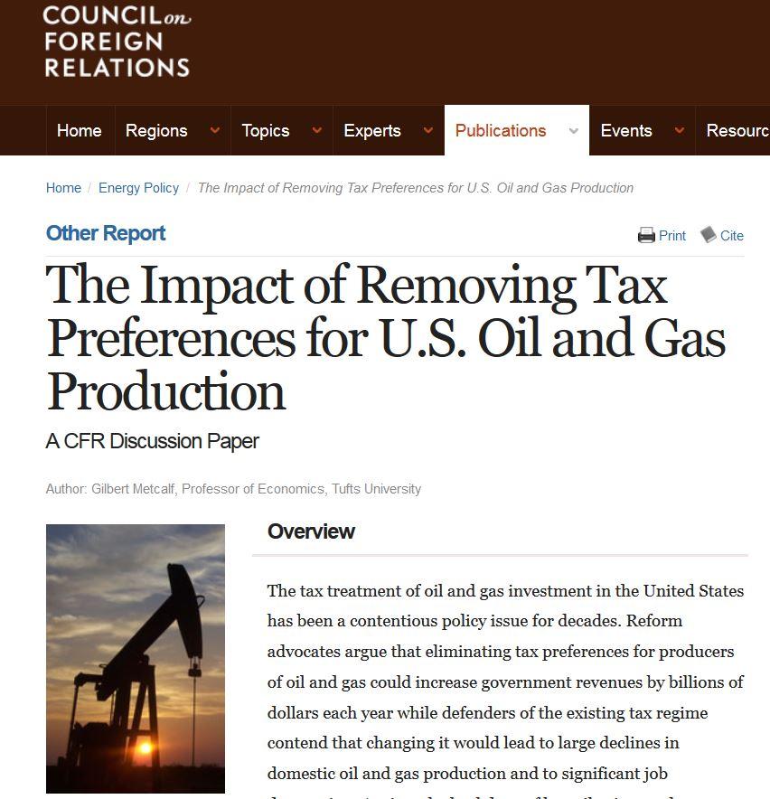
Topics
Thoughts on a carbon tax
Tax preferences for oil & gas production
R&D

Slide 16
Reforming the Tax Code
G20 initiative to eliminate wasteful fossil fuel subsidies
Metcalf (2016) models elimination of 3 largest U.S. oil & gas tax preferences
  Measures impacts on domestic production, price, and global consumption
  Embeds domestic supply model in a global model of oil markets

Slide 17
Global Oil Model
Supply
Demand
United States
(13.2 MBD)
OPEC
(44.4 MBD)
Consumers
(107.4)
Rest of World
(49.8 MBD)
EIA 2030 Reference Case

Slide 18
Oil Market Impacts
Global Oil Price Scenarios | U.S. Tax Policy Options | How OPEC Responds to Lower U.S. Production | Global Price, $2012/ bbl (% change) | Global Supply, mbd (% change) |  |  | Global Demand, mbd (% change)
 |  |  |  | U.S. | OPEC | ROW
EIA Reference Case: $119/bbl in 2030 | Baseline | N/A | $ 119.00 | 13.2 | 44.4 | 49.8 | 107.4
 | Repeal Major Preferences | OPEC Supply Responds to Price | $ 119.75 (0.6%) | 12.6 (-4.8%) | 44.5 (0.3%) | 50.0 (+0.3%) | 107.1 (-0.3%)
 |  | OPEC Maintains Constant Market Share | $ 120.30 (1.1%) | 12.6 (-4.6%) | 44.1 (-0.5%) | 50.1 (+0.5%) | 106.9 (-0.5%)
EIA Low Price Case: $72/bbl in 2030 | Baseline | N/A | $ 72.00 | 11.7 | 54.6 | 44.2 | 110.6
 | Repeal Major Preferences | OPEC Supply Responds to Price | $ 72.39 (0.5%) | 11.2 (-4.8%) | 54.8 (0.3%) | 44.3 (+0.3%) | 110.3 (-0.3%)
 |  | OPEC Maintains Constant Market Share | $ 72.79 (1.1%) | 11.2 (-4.6%) | 54.3 (-0.5%) | 44.5 (+0.5%) | 110.0 (-0.5%)
Source: Author's calculations. 5% domestic supply shift
Notes:
Results are unchanged if I use a supply elasticity of .36 for all supply functions

Slide 19
Assessment
Energy Security?
  Energy security depends on oil consumption, not domestic produciton
  No impact – consumption barely budges;
Climate Change?
  Modest impact on emissions; note 50 percent leakage
  Larger effect in international negotiations
Budget?
  Saves $4 billion in lost tax revenues each year

Slide 20
Topics
Thoughts on a carbon tax
Tax preferences for oil & gas production
R&D

Slide 21
Research and Development:
The Problem
Pure public good – underprovided in competitive markets
Why it matters?
  Every scenario to achieve deep decarbonization relies on technologies that don’t yet exist or that are not politically acceptable at current cost
Impediments to public R&D
  The Solyndra problem

Slide 22
Research and Development:
Moving Forward
Clean energy R&D: $6.4 billion in FY 2016
  Mission Innovation: double clean energy R&D by FY 2021
  ARPA-E funded at ~$250 million
    Mission Innovation raises this to $350 million in FY 2017
New innovative funding models needed
  Possible examples:
    CCS tournament – benefits to first movers
    Government guaranteed payment price floor for stored carbon – addresses policy risk

Slide 23
Summing Up
Designing a carbon tax easy
  Implementing it is harder
  Implementing a meaningful carbon tax is harder still
    Will need thoughtful blend of economics and political science to do this
No good rationale for current tax treatment of domestic oil & gas production
  Eliminating major oil & gas tax preferences would have modest impacts on domestic drilling in the short run and domestic production in the long run
  Revenue savings of over $4 billion per year from repeal
R&D underfunded
  But we want smart R&D initiatives

Slide 24


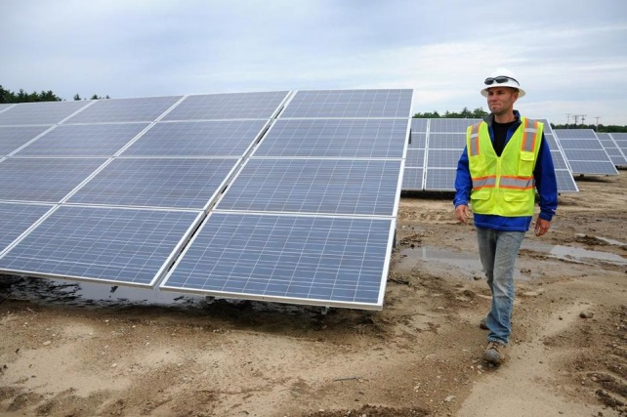
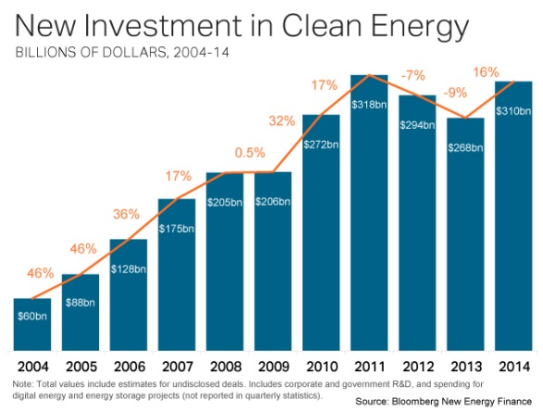
Thank You
Gilbert Metcalf
http://works.bepress.com/gilbert_metcalf/

