Slide 1
Do Energy Conservation Investments Deliver? The Role of Energy Efficiency in Climate Policy
Erica Myers
Agricultural and Consumer Economics
University of Illinois

Slide 2
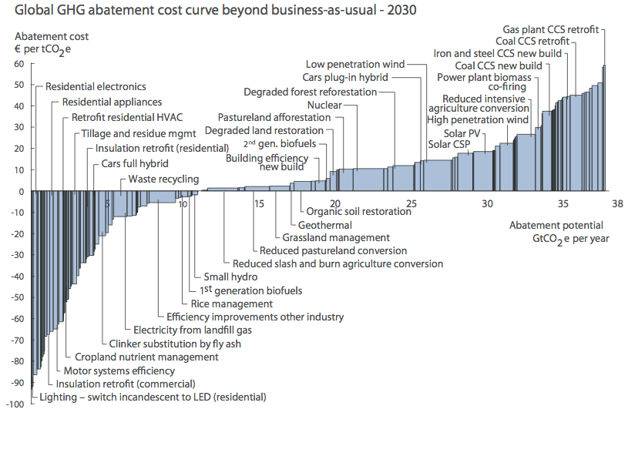
Energy Efficiency often touted as one of the most cost effective way to reduce GHGs
Source: McKinsey and Company, “Pathways to a Low-Carbon Economy,” 2010

Slide 3
Key Policy Makers on Energy Efficiency
“For the next few decades energy efficiency is one of the lowest cost options for reducing U.S. carbon emissions. Many studies have concluded that energy efficiency can save both energy and money.“
-Former Secretary of Energy, Steven Chu
“I'm also issuing a new goal for America: let's cut in half the energy wasted by our homes and businesses over the next twenty years..."
-President Obama, State of the Union Address, February 2013
“Energy efficiency...it's going to be the focal point of my time as secretary"
-Ernie Moniz, Secretary of Energy

Slide 4
Big Money Spent on EE
The American Recovery and Reinvestment Act
$97 billion in energy related funding
$32 billion of which went to energy efficiency and retrofits (U.S. Congressional Budget Office, 2009)
LBNL Analysis of Utility Customer Funded EE Spending
$5+ billion spent annually
Spending will almost double by 2025 (Barbose et al., 2013)

Slide 5
Energy Efficiency is a Significant Component of Prominent GHG Policies

Slide 6
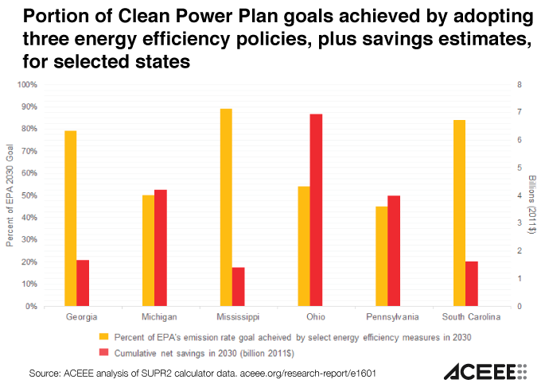
EPA’s Clean Power Plan:

Slide 7
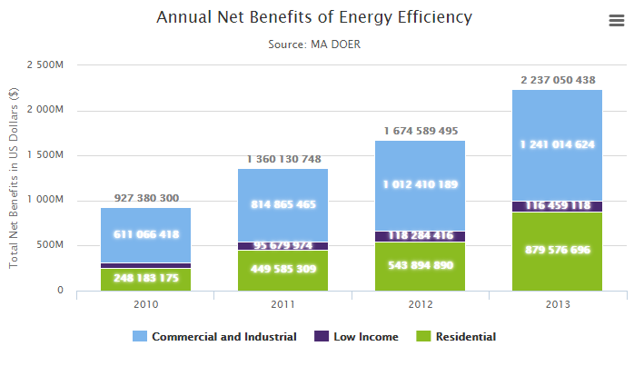
Massachusetts Global Warming Solutions Act of 2008: more than 1/3 reductions from EE improvements to buildings and appliances

Slide 8
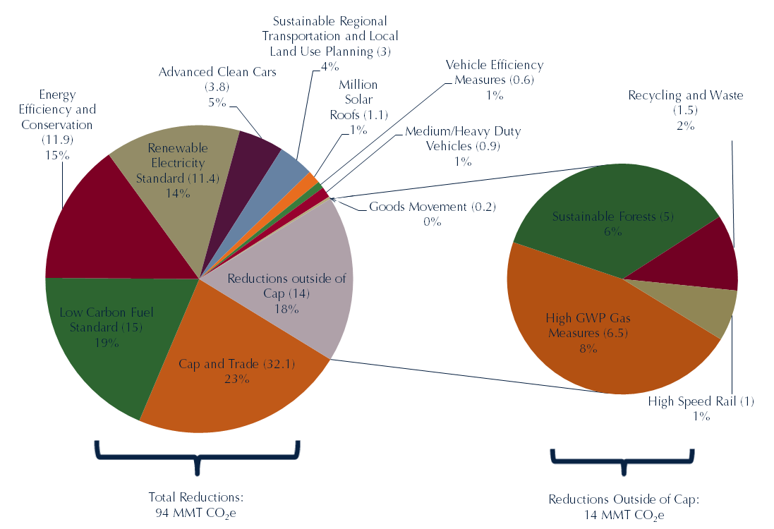
Almost 15% of GHG reductions from California’s AB 32 projected to come from building and appliance efficiency programs
Source: CARB, Greenhouse Gas Reductions from Ongoing, Adopted and Foreseeable Scoping Plan Measures

Slide 9
How is EE Potential Calculated?
Source: McKinsey and Company, “Pathways to a Low-Carbon Economy,” 2010

Slide 10
How is EE Potential Calculated?
Difference in “Life Cycle Cost” between standard and efficient appliances
“Life Cycle Cost” has two components
Purchase and installation cost
Operating costs summed over life time

Slide 11
Research Agenda For Economists
Why aren’t these seemingly cost effective measures being taken up in the absence of public policy?
i.e. If there are dollar bills on the ground, why is no one picking them up?

Slide 12
Can We Identify “Market Failures” that Lead to Sub-Optimal Investment?
“Non-optimizing” Behavior
Inattention
Saliency Effects
Status Quo Bias
Principal-Agent Problems

Slide 13
Sometimes, But These Are Often Small

Slide 14
Projected Savings Typically Over-Estimate Realized Savings
Weatherization Assistance Program (Fowlie et al. 2015)
Appliance rebate programs (Houde and Aldy 2014, Davis et al. 2014)
Building codes (Levinson, 2015).

Slide 15
What is driving the wedge between projected and realized savings?
Workmanship
Occupant behavior
Modelling

Slide 16
Can We Blame the Workers?
Source: Blansnik 2013

Slide 17
Can We Blame the Occupants?
Some say actual energy use has little to do with house efficiency because effects of particular occupants can have such a large effect
Hard to measure occupancy impact, Blasnik 2013, tries to bracket it

Slide 18
Blasnik 2013’s Approach
Analysis of Midwestern gas utility customers
Weather-adjusted gas use in 2012 vs. 2009
Owner-occupied single family homes
Results for 79,805 movers and 545,136 stayers

Slide 19
Gas Use: Movers vs. Stayers
Source: Blansnik 2013
Median Abs. Change in Gas Use: Movers=15%, Stayers=8%
Within ±25% of prior use: Movers=71%, Stayers=90%

Slide 20
How About Modelling?
Engineers do a pretty good job with newer, efficient houses
Energy consumption and the effect of EE improvements of existing housing stock much harder to predict
Ex-post evaluation of the realized savings from these measures could help to calibrate the models and increase accuracy

Slide 21
720 Energy Star New Homes in Midwest Actual vs. Projected Gas Heating Usage
Source: Blansnik 2013
REM-projected avg. heating use 656 vs. 662 actual
Typical (median) discrepancy= 16%

Slide 22
Houston Energy Star Homes Study
actual vs. predicted cooling
10,258 homes
Lots of scatter
17% Median diff
Source: Blansnik 2013

Slide 23
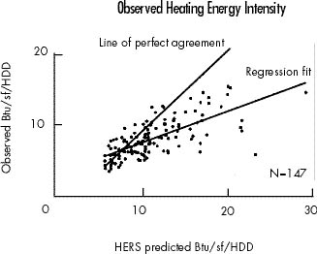
Modeling Existing Homes: Wisconsin Home Energy Rating System (HERS) Study
Projected use 22% high on average
“badly overestimated for inefficient homes”
Source: “A Rating Tale”, S. Pigg, Home Energy Magazine Jan/Feb 2001

Slide 24
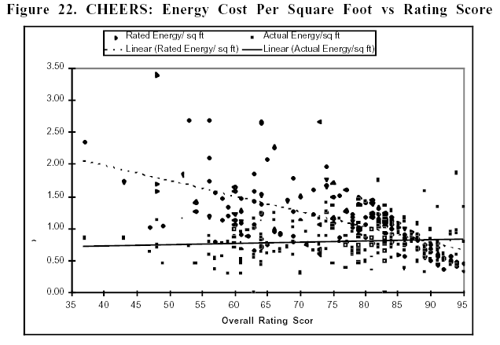
California Home Energy Efficiency Rating Services (CHEERS): 1997
No relationship between rating and actual energy usage intensity !?
Source: “Accuracy of Home Energy Rating Systems”LBNL 40394 study, J. R Stein 1997

Slide 25
Takeaways
Energy Efficiency is here to stay in climate policy and utility programs
Program goals can be undermined if EE not properly accounted for
More ex-post analyses needs to be done to compare projected to realized energy consumption from EE measures
As more studies estimate realized savings on a per measure basis, we can decompose the wedge and try to better predict energy efficiency benefits for public policy

